Slide 1
Food and Beverage Management fifth edition
Appendix C
Budget and Trading Results
comparison and evaluation

Slide 3
Budget and trading results
The next slide gives the budget and trading results for a food service operation
The task is to analyse the results and to evaluate the operation based on the data
Guidance is given on both the analysis of the figures and the evaluation of the operation

Slide 4
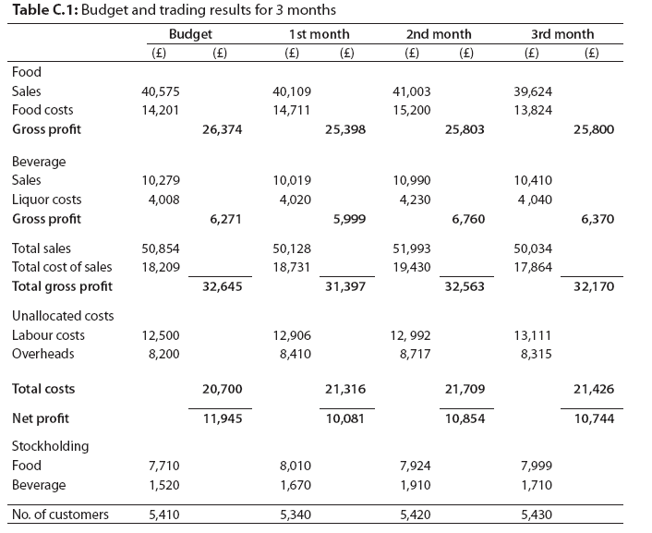

Slide 5
Analysis of the figures should include:
Trading figures together with percentages
Stock turnover
Percentage variance against budget
Percentage for food and beverage sales of the total sales
Average spend per head on food and beverage
Average seat turnover
Worked examples are on the next three slides

Slide 6
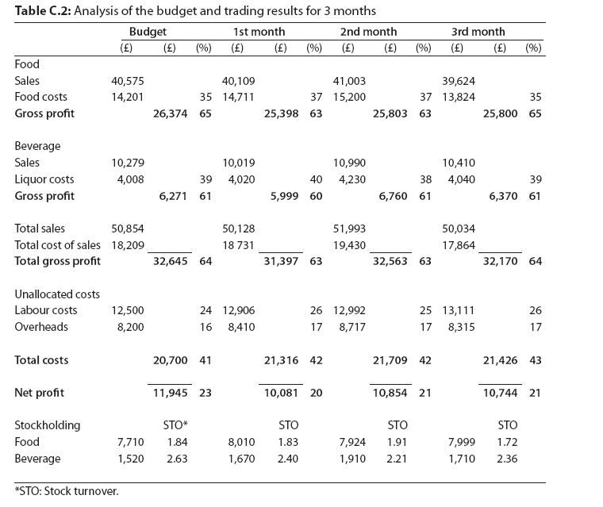

Slide 7
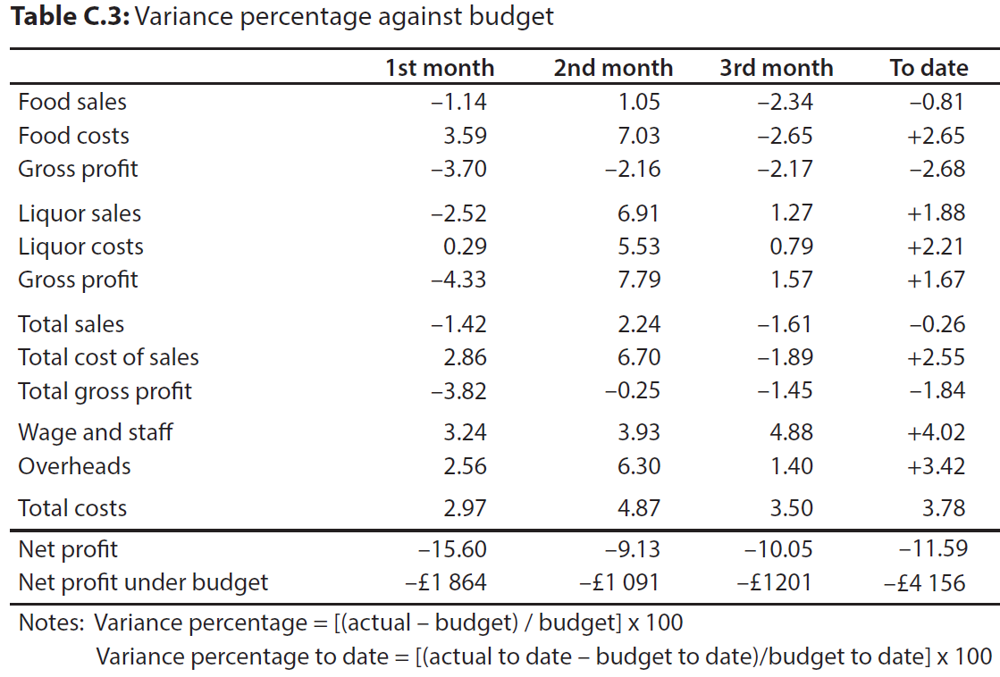

Slide 9
Evaluation of the data should identify:
Apparent strengths of the operation
Areas for concern
A general overview of the current potion, and
An identification of information that would help to make the evaluation more compete
Example summary of the evaluation is given on the next four slides

Slide 10
Apparent strengths:
Conservative budget (given the number of seats) and targets for sales are being met
Reasonable match between spend and number of customers and budget with the principal problem being costs
For more detail of the evaluation refer to Annex C of the book

Slide 11
Areas for concern:
Food costs
Liquor costs
Stock turnover
Wage costs
Overheads
Overall performance of restaurant is poor against budget
Reduced net profit
For more detail of the evaluation refer to Annex C of the book

Slide 12
General overview:
Sales on food more or less static on budget while drink sales are slightly over budget
Main problems are costs
Overall there is a need to reduce costs to budget or increase sales to achieve targeted net profit
Assuming the budget to be accurate, and that costs can be brought under control, there may be little need for change
For any further assessment additional information is required

Slide 13
Additional information required:
Basis of budget formulation
Previous trading information
Nature of demand being met
Sales mix analysis
Reason for higher food costs
Reason for drink sales increase
Staffing information and breakdown of wage costs
Reasons for the high variance in overhead costs
Assessment of the business environment

